Slide 1
CS 111 Discussion - 3
Gayathri Muralidharan

Slide 2
Topics to be covered
Socket
Mcrypt
Encryption Example
Client program
Server program

Slide 3
Socket
Client side:
1) Socket Creation
int socket (int namespace, int style, int protocol);
This function creates a socket and specifies communication style style. The namespace argument specifies the namespace; protocol designates the specific protocol (see Socket Concepts); zero is usually right for protocol.
2) Making a connection
int connect (int socket, struct sockaddr *addr, socklen_t length);
The connect function initiates a connection from the socket with file descriptor socket to the socket whose address is specified by the addr and length arguments. (This socket is typically on another machine, and it must be already set up as a server.)

Slide 4
struct sockaddr_in
{
sa_family_t sin_family;
in_port_t sin_port;
struct in_addr sin_addr;
}
struct in_addr
{
uint 32_t s_addr;
}
Besides the standard numbers-and-dots notation for Internet addresses, you can also refer to a host by a symbolic name
struct hostent * gethostbyname (const char *name)
struct hostent
{
char *h_name;
Int length;
….
}

Slide 5
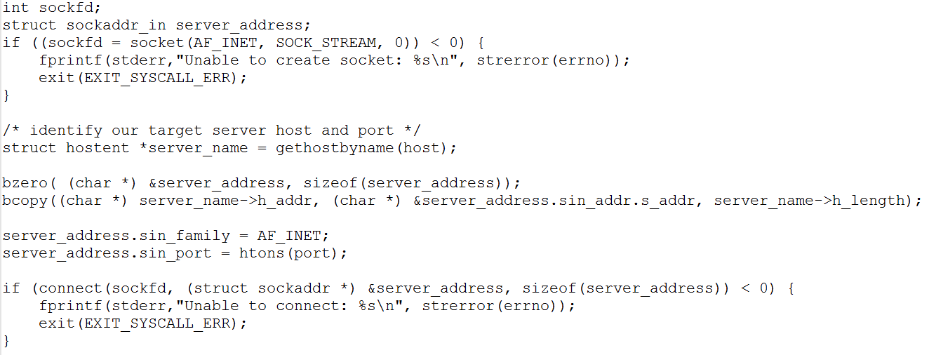

Slide 6
Server Side:
1)Listening for connection requests
int listen (int socket, int n);
The listen function enables the socket socket to accept connections, thus making it a server socket. The argument n specifies the length of the queue for pending connections. When the queue fills, new clients attempting to connect fail with ECONNREFUSED until the server calls accept to accept a connection from the queue.
2) Accepting Connections:
int accept (int socket, struct sockaddr *addr, socklen_t *length_ptr);
The addr and length-ptr arguments are used to return information about the name of the client socket that initiated the connection.Accepting a connection does not make socket part of the connection. Instead, it creates a new socket which becomes connected. The normal return value of accept is the file descriptor for the new socket.After accept, the original socket socket remains open and unconnected, and continues listening until you close it. You can accept further connections with socket by calling accept again.

Slide 7
3) Binding address of a socket:
int bind(int sockfd, const struct sockaddr *addr, socklen_t addrlen);
When a socket is created with socket(2), it exists in a name space (address family) but has no address assigned to it. bind() assigns the address specified by addr to the socket referred to by the file descriptor sockfd. addrlen specifies the size, in bytes, of the address structure pointed to by addr. Traditionally, this operation is called “assigning a name to a socket”.

Slide 8
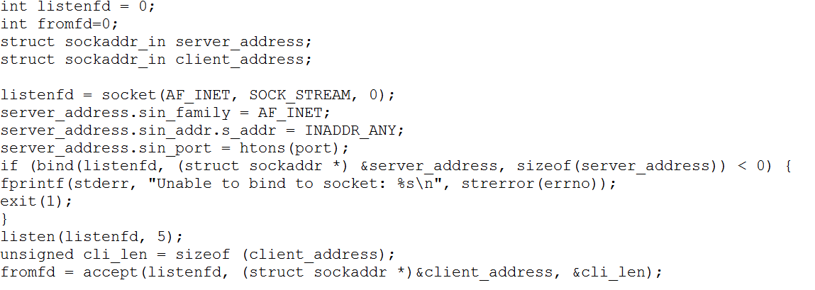

Slide 9
MCRYPT
MCRYPT mcrypt_module_open( char *algorithm, char* algorithm_directory, char* mode, char* mode_directory);
This function associates the algorithm and the mode specified. The name of the algorithm is specified in algorithm, eg "twofish", and the algorithm_directory is the directory where the algorithm is (it may be null if it is the default). The same applies for the mode. The library is closed by calling mcrypt_module_close(), but you should not call that function if mcrypt_generic_end() is called before. Normally it returns an encryption descriptor, or MCRYPT_FAILED on error.

Slide 10
int mcrypt_generic_init( MCRYPT td, void *key, int lenofkey, void *IV);
This function initializes all buffers for the specified thread The maximum value of lenofkey should be the one obtained by calling mcrypt_get_key_size() and every value smaller than this is legal. You must obtain the size of IV by calling mcrypt_get_iv_size(). After calling this function you can use the descriptor for encryption or decryption (not both). Returns a negative value on error.
int mcrypt_generic( MCRYPT td, void *plaintext, int len);
This is the main encryption function. td is the encryption descriptor returned by mcrypt_generic_init(). Plaintext is the plaintext you wish to encrypt and len should be the length (in bytes) of the plaintext and it should be k*algorithms_block_size if used in a mode which operated in blocks (cbc, ecb, nofb), or whatever when used in cfb or ofb which operate in streams. The plaintext is replaced by the ciphertext. Returns 0 on success.

Slide 11
int mdecrypt_generic( MCRYPT td, void *ciphertext, int len);
The decryption function. It is almost the same with mcrypt_generic. Returns 0 on success.
int mcrypt_generic_deinit( MCRYPT td);
This function terminates encryption specified by the encryption descriptor (td). Actually it clears all buffers. The difference with mcrypt_generic_end() is that this function does not close the modules used. Thus you should use mcrypt_module_close(). Using this function you gain in speed if you use the same modules for several encryptions. Returns a negative value on error.
int mcrypt_module_close( MCRYPT td);
This function closes the modules used by the descriptor td.

Slide 12
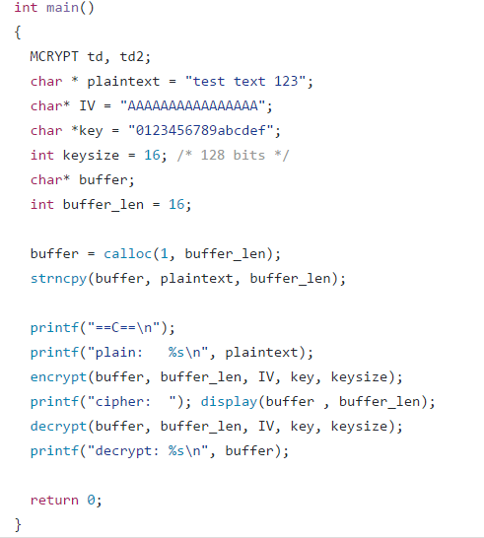
Encryption Example

Slide 13
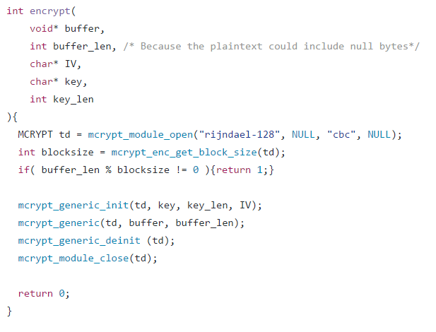
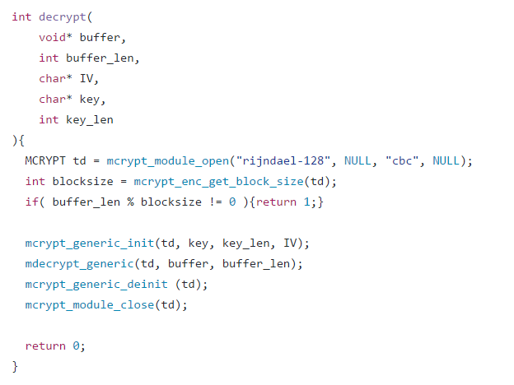

Slide 14
Client Process
Create a socket
Call the connect method (for obtaining the server’s address , we can use getHostByName method).
Set to raw mode.
Then do a polling between reading from keyboard and reading from port.
Whatever is read from keyboard, process the input, encrypt, echo and write to the port.
Whatever is read from port, process the output, decrypt and write to stdout.
Shutdown the socket, restore normal mode
Call mcrypt_generic_deinit() and mcrypt_module_close() methods.

Slide 15
Server Process
Create a socket.
Bind the address.
Listen.
Accept.
Spawn a child process (create to pipes like before).
Child process executes the shell.
Parent process polls between reading from the port and reading from the shell.
Process what is read from port, decrypt and write to shell.
Process what is read from shell, encrypt and write to port.

